Slide 1
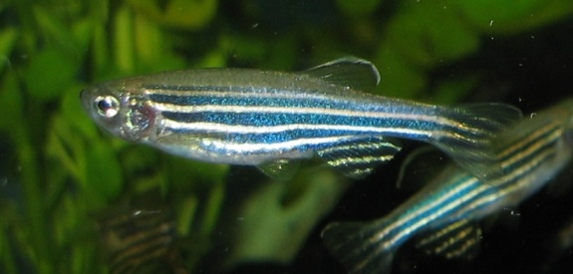
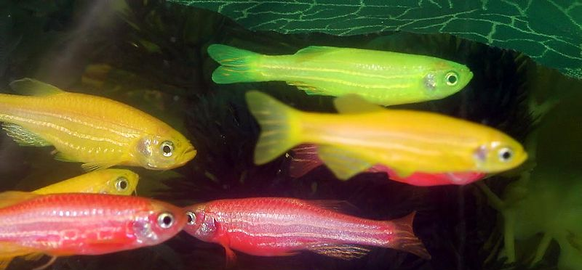
Science of Living System (BS20001)
SOUMYA DE
Office: 2nd Floor, Diamond Jubilee Building
Phone: 03222-284552
E-mail: somde@iitkgp.ac.in

Slide 2
Genetic Engineering
Manipulation of an organism’s genome
Can range from changing one base pair (A-T or C-G), deleting a whole region of DNA, or introducing an additional copy of a gene
Extracting DNA from an organism’s genome and combining it with the DNA of another individual
Used to enhance or modify the characteristics of an individual organism

Slide 3
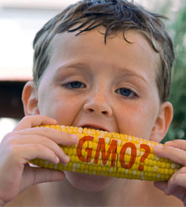
An Overview of Genetic Engineering
Agricultural application (Bt Cotton, Genetically
modified sweet corn)
Bacillus thuringiensis
Application in Dairy, Poultry Farms etc (Growth hormones to increase production of cow milk)
Environmental application (Pseudomonas putida, an oil eating bacteria)
Therapeutic application (Human insulin, many growth hormones, etc)
Notes:
Bt cotton was first approved for field trials in the United States in 1993, and first approved commercial use in the United States in 1995.^{[3]} Bt cotton was approved by the Chinese government in 1997.^{[4]}
In 2002, a joint venture between Monsanto and Mahyco introduced Bt cotton to India.^{[5]}
In 2011, India grew the largest GM cotton crop at 10.6 million hectares. The U.S. GM cotton crop was 4.0 million hectares, the second largest area in the world, followed by China with 3.9 million hectares and Pakistan with 2.6 million hectares.^{[6]} By 2014, 96% of cotton grown in the United States was genetically modified^{[7]} and 95% of cotton grown in India was GM.^{[8]} India is the largest producer of cotton, and GM cotton, as of 2014.

Slide 4
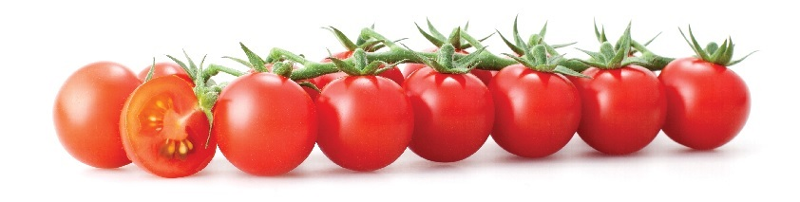
Genetically modified Product
Flavr Savr (also known as CGN-89564-2; pronounced "flavor saver"), a genetically modified tomato
Glow Fish: Zebra fish with green fluorescent protein (GFP) and others
Wild type zebra fish
Glow fish (genetically modified fish)

Slide 5
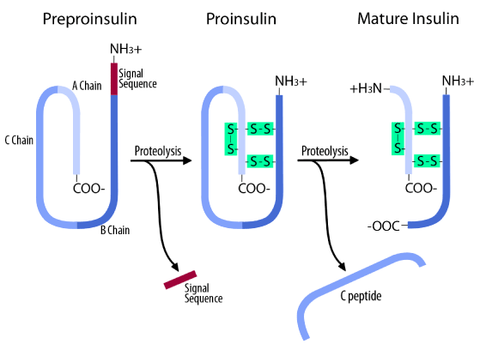
Production of Human Insulin: The best example of Genetic Engineering/Recombinant DNA Technology

Slide 6
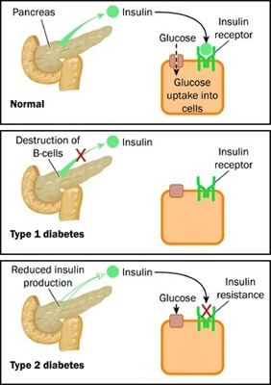
Insulin: an indispensable hormone in our body
Insulin is a hormone that regulates the amount of glucose (sugar) in the blood and is required for the body to function normally.
Insulin is produced by cells in the pancreas, called the islets of Langerhans.
These cells continuously release a small amount of insulin into the body, but they release surges of the hormone in response to a rise in the blood glucose level.
(β-cells)
β-cells
Every time a person eats, the blood glucose rises. Raised blood glucose triggers the cells in the islets of Langerhans to release the necessary amount of insulin. Insulin allows the blood glucose to be transported from the blood into the cells.
Once transported into the cell, the blood glucose level is returned to normal within hours.
Notes:
Problems in the production or regulation of pancreatic hormones will cause complications related to blood sugar imbalance. Of all the diseases and disorders of the pancreas, the most well-known is diabetes.
Type 1 diabetes: Autoimmune disorder where insulin producing islets of Langerhans cells die. So, body doesn’t produce enough/any insulin to handle the glucose. People with type 1 diabetes have to take insulin to help their body use glucose appropriately.
Type 2 diabetes: much more prevalent. People with type 2 diabetes may be able to produce insulin, but their bodies don’t use it correctly (insulin resistance). They might also be unable to produce enough insulin to handle the glucose in their body. Lifestyle choices, such as diet and exercise, play a major role in managing and preventing type 2 diabetes.

Slide 7
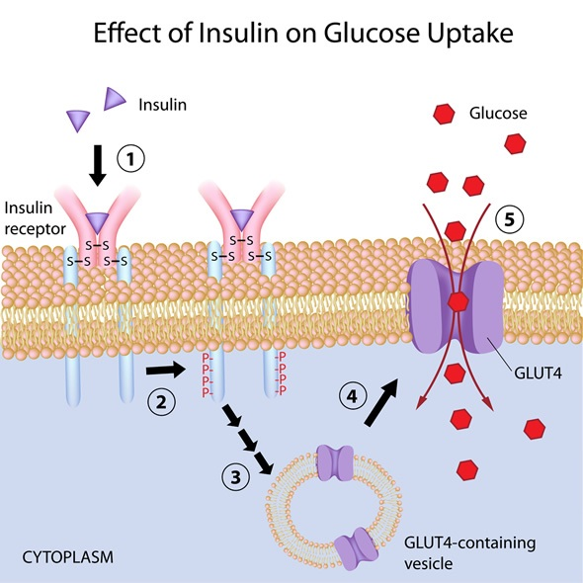

Slide 8
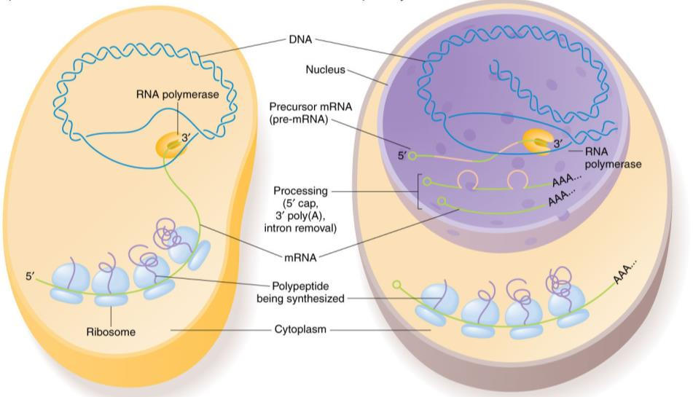
Bacteria
Eukaryote

Slide 9
Production of Insulin
1921: Frederick Banting and Charles Best successfully purified insulin from a dog's pancreas. Over the years scientists made continual improvements in producing insulin.
In the 1980s, researchers used genetic engineering to manufacture a human insulin.
In 1982, the Eli Lilly Corporation produced a human insulin that became the first approved genetically engineered pharmaceutical product.
At present, researchers could produce genetically engineered insulin in unlimited supplies without depending on animals.
HOW??
Genetic Engineering

Slide 10
Key Words in Genetic Engineering
Gene of interest: DNA segment that is to be inserted or deleted
Plasmid: a small, circular, double-stranded DNA molecule that is distinct from a cell's chromosomal DNA (commonly found in bacteria and may provide antibiotic resistance)
Vector: DNA molecule (such as plasmid) used as a vehicle to carry gene of interest (or foreign genetic material) into another cell where it can be expressed
Transformation: Transfer of gene of interest in to a host cell (may be bacteria) where it can be maintained as well as expressed.
Clone: Organisms carrying identical genes

Slide 11
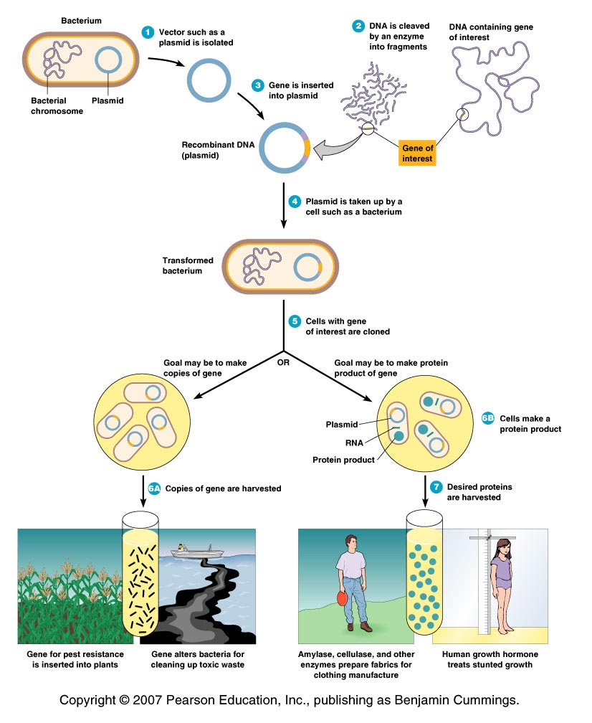
An Overview of Genetic Engineering
1. Gene of interest (DNA) is isolated
(DNA fragment)
2. A desired gene is inserted into a DNA molecule - vector
(plasmid, bacteriophage or a viral genome)
3. The vector inserts the DNA into a new cell, which is grown to form a clone.
(bacteria, yeast, plant or animal cell)
4. Large quantities of the gene product can be harvested from the clone.

Slide 12

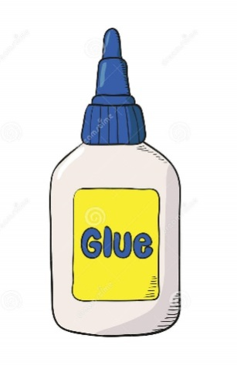


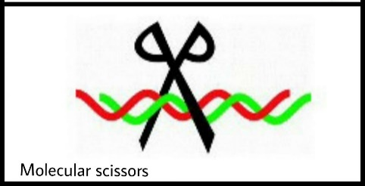
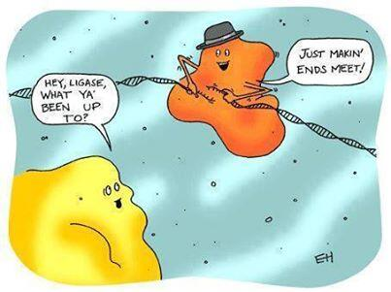
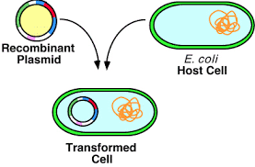
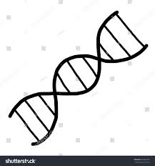
Tools for making a collage
Colourful papers
Scissors
Glue
Drawing paper
DNA of interest
Restriction enzymes
Ligase enzyme
Host organism
Tools for making a Recombinant DNA

Slide 13

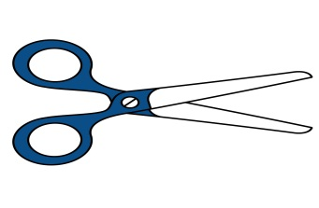

Tools for Genetic engineering 1. Restriction Enzymes
Naturally produced by bacteria – restriction endonucleases
Natural function - destroy bacteriophage DNA in bacterial cells
Cannot digest host DNA with methylated C (cytosine)
A restriction enzyme
Substrate –DNA -recognizes one particular nucleotide sequence in DNA and cuts the DNA molecule (breaks down the bond between two nucleotides)
Prepackaged kits are available for rDNA techniques
sticky ends
Palindrome
blunt ends

Slide 14
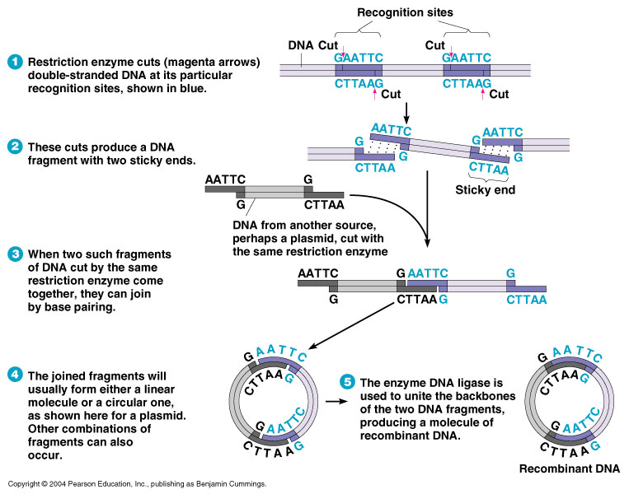
Restriction Enzymes: How it Works?
Fragments of DNA produced by the same restriction enzyme will spontaneously join by base pairing.
Each of the DNA strands will have a break

Slide 15
Frequency of occurrence of restriction sites
If DNA sequence has equal amounts of each base
If bases are distributed randomly
6 base cutter
(1/4)⁶ = 1 site in ~4000 bp
4 base cutter
(1/4)⁴ = 1 site in 256 bp

Slide 16
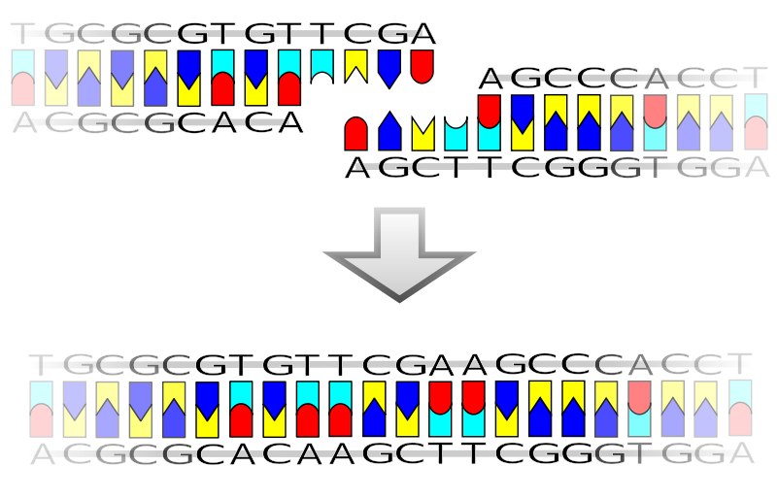

Tools for Genetic engineering 2. Ligase
DNA ligase is a enzyme that can link together DNA strands that have double-strand breaks (a break in both complementary strands of DNA).
Naturally DNA ligase has applications in both DNA replication and DNA repair .
Needs ATP
DNA ligase has extensive use in molecular biology laboratories for genetic recombination experiments
ATP

Slide 17
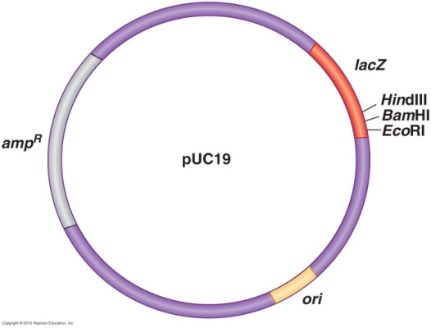
Tools for Genetic engineering 3. Plasmids
Vectors - Small pieces of circular DNA used for cloning
Requirements of the Vector
1. Self-replication - able to replicate in the host (independent origin of replication)
2. Cloning site -(region containing multiple restriction sites)
3. Promoter (and operator) - to support the expression of insert DNA (i.e. gene of interest) in the host.
4. Selectable marker – antibiotic resistance (Ampicillin resistant)
5. Proper size- for easy handling

Slide 19
Hosts for Recombinant DNA Technology
Bacteria
E. coli - used because is easily grown and its
genomics are well understood.
Gene product is purified from host cells
2. Yeasts - Saccharomyces cerevisiae
Used because it is easily grown and its genomics are known
May express eukaryotic genes easily
Continuously secrete the gene product.
Easily collected and purified
3. Plant cells and whole plants
May express eukaryotic genes easily
Plants are easily grown - produce plants with new properties.
4. Mammalian cells
May express eukaryotic genes easily
Harder to grow
Medical use.

Slide 20
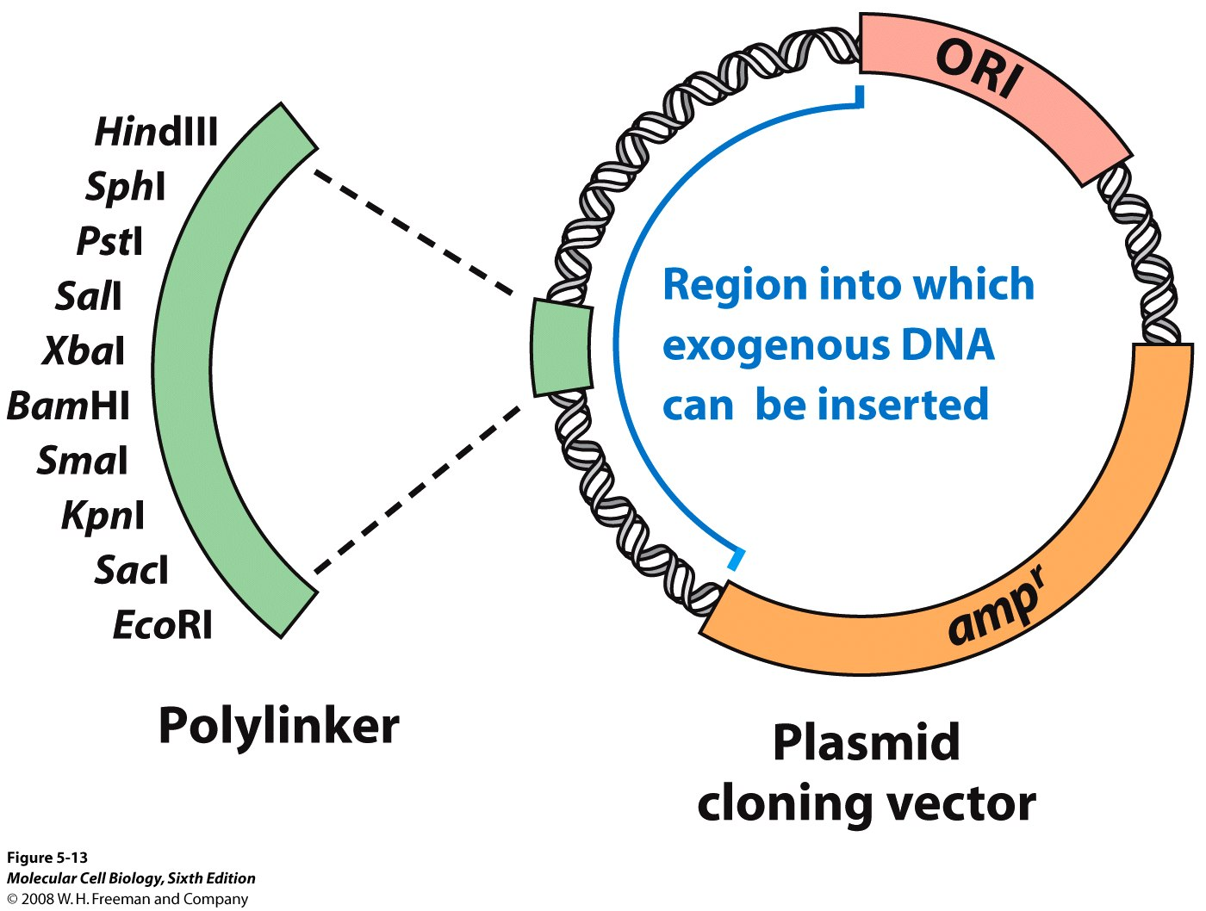
Cloning of a Gene

Slide 21
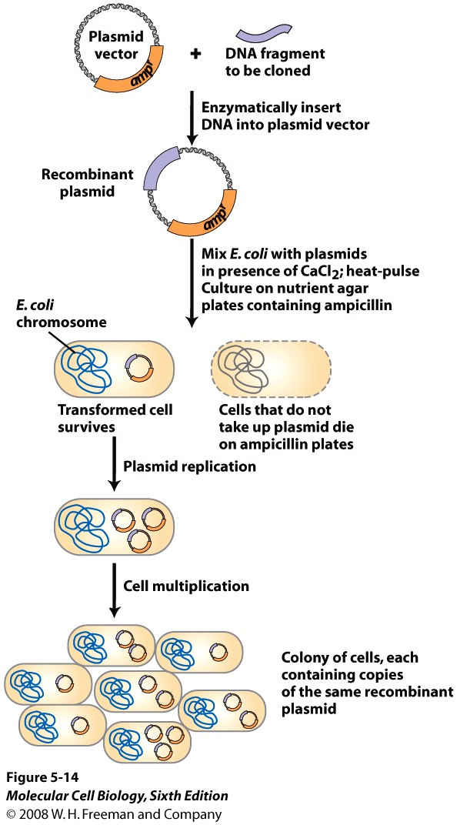
Cloning and Transformation of a Gene

Slide 22
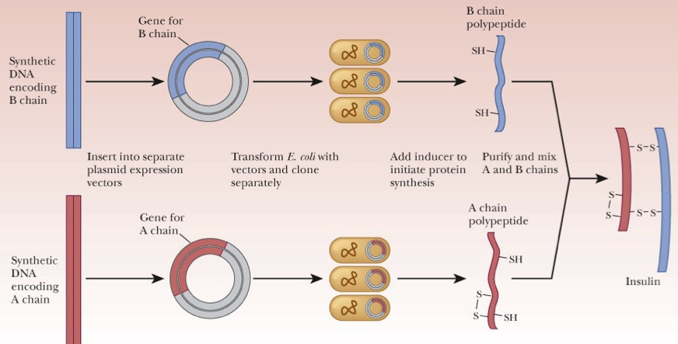
Production of Insulin through Genetic Engineering Approach

Slide 23
Cloning Whole Animals
Two techniques
- Embryo splitting
- Nuclear transfer

Slide 24
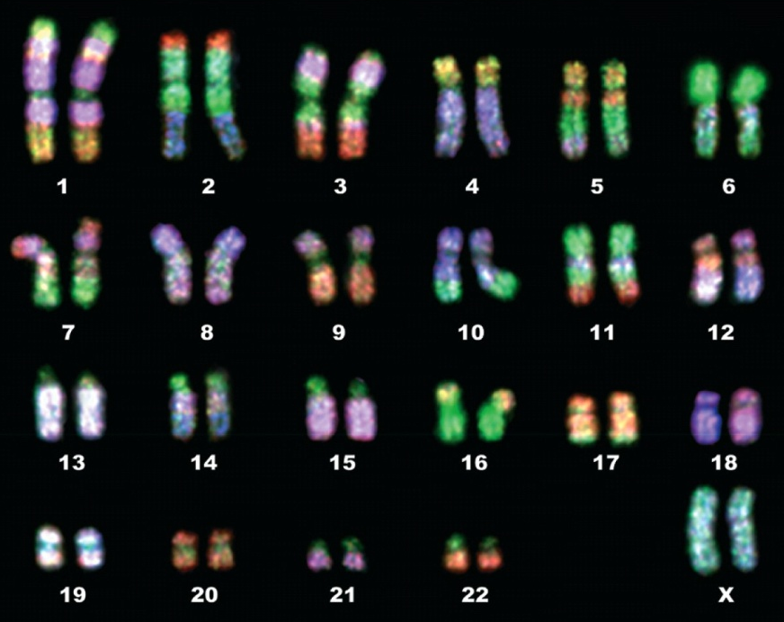
Somatic cells are diploid (2n) and Gametes (sperm/ovum) are haploid (n)
Most higher eukaryotes are diploid (2n); i.e. their body (somatic) cells contain two copies of the genome set (two sets of homologous chromosomes)
Their sex cells (gametes) are haploid (n) i.e. these cells contain one copy of the genome set (one set of each chromosomes)
Chromosomes
haploid 1 set
diploid 2 sets
triploid 3 sets
tetraploid 4 sets
hexaploid 6 sets
octaploid 8 sets
Diploid set of human chromosomes
Notes:
Why eukaryotic chromosomes are linear?
This is important/necessary for recombination.
Banana is triploid. Watermelons, some frogs are tetraploids. Wheat is hexaploid.

Slide 25
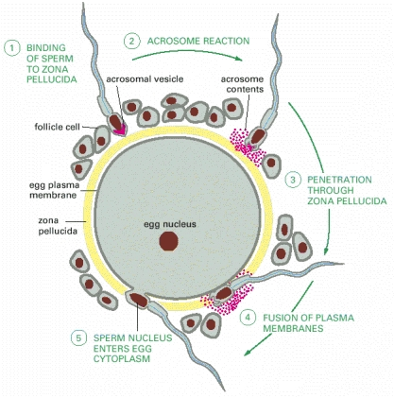
How does the ‘2n’ genome arise in embryo?
Through fertilization of two sex cells (gametes): one basic genome set (n) from male gamete (father’s sperm) and another set (n) from female gamete (mother’s egg).
Sperm
Ovum
n
n
X
(gametes)
fertilization
2n
(n)
Embryo
(n)
So gametes need to be haploid (n)
How do we get haploid gametes in a diploid organism?

Slide 26
In eukaryotic organism, two different types of cell divisions occur
Mitosis (equal division): When the somatic (body) cells just increase in number.
One cell ---→ (genome duplication & segregation into two) ----→ Two cells
2n ---(4n)---→ 2n + 2n
n ---(2n)---→ n + n
Meiosis (reduction division): For sexually reproducing diploid organism specialized diploid cells (meiocytes) undergo two sequential nuclear divisions to form four haploid cells.
One cell ----→ (genome duplication & segregation into four) ----→ Four cells
2n ---(4n)---→ (2n) + (2n) ----→ n + n+ +n + n
These haploid cells are called gametes (sperms and eggs in plants, animals) or spores (fungi, algae).
Notes:
26

Slide 27
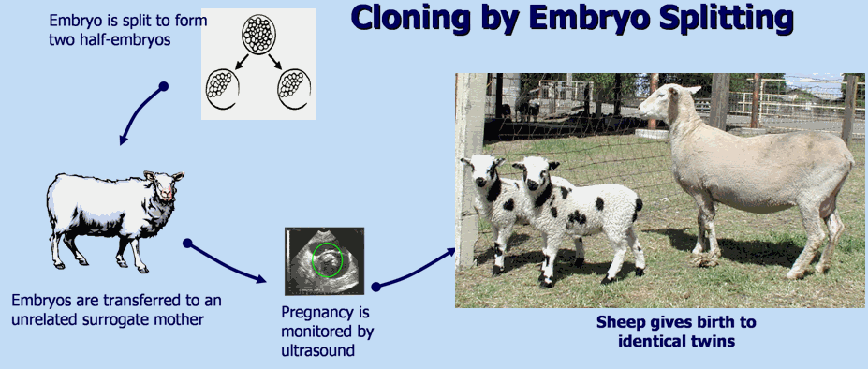
Embryo Splitting
Egg collected
Fertilized by in vitro fertilization (IVF)
Embryo is grown to 8–16 cells
Cells are separated
Separated cells grown into separate embryos
Embryos transplanted into surrogate mothers

Slide 28
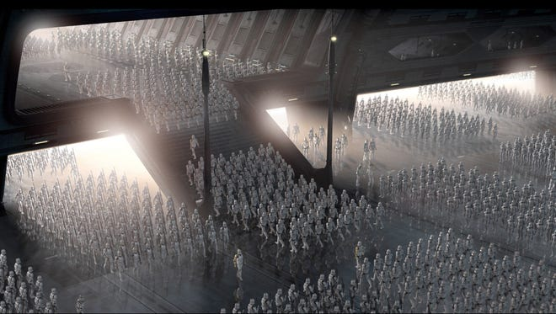


Slide 29
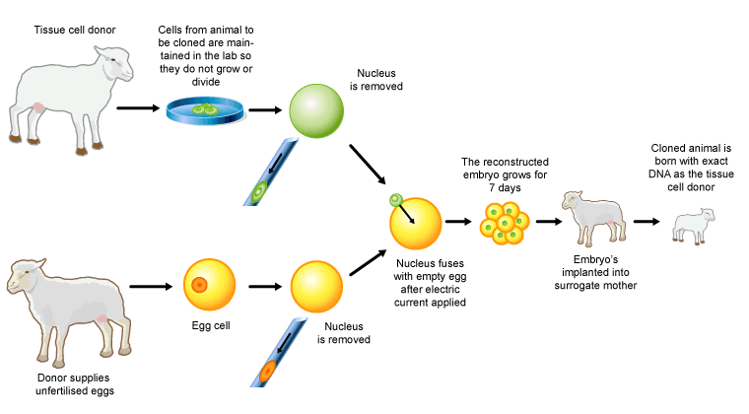
Cloning Whole Animals
Nuclear Transfer

Slide 30

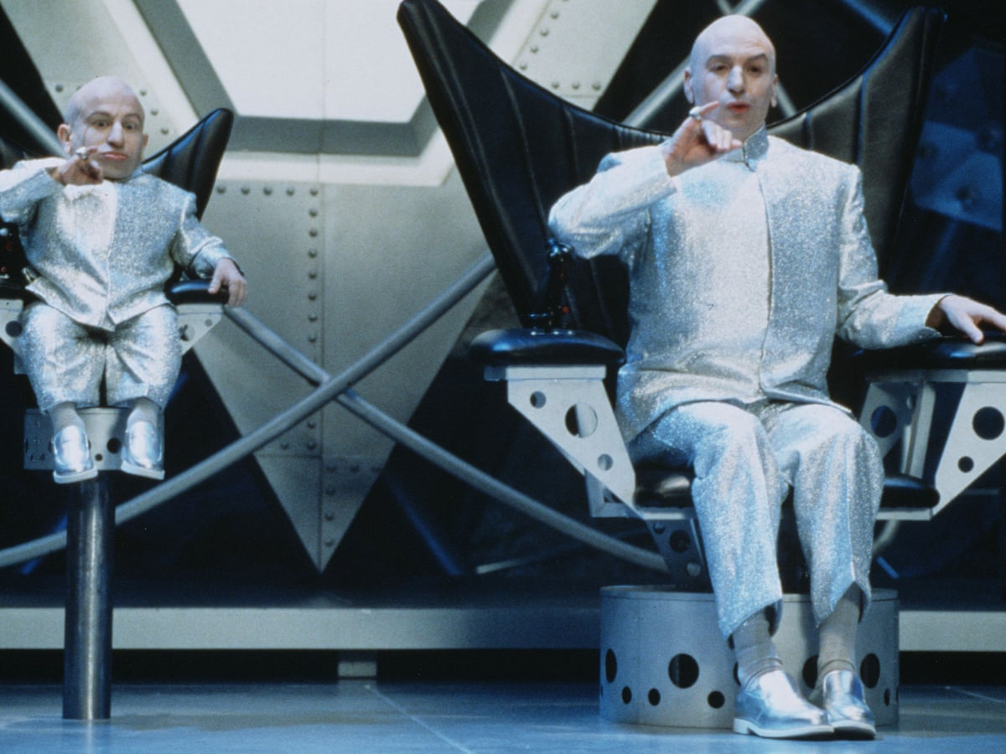

Slide 31
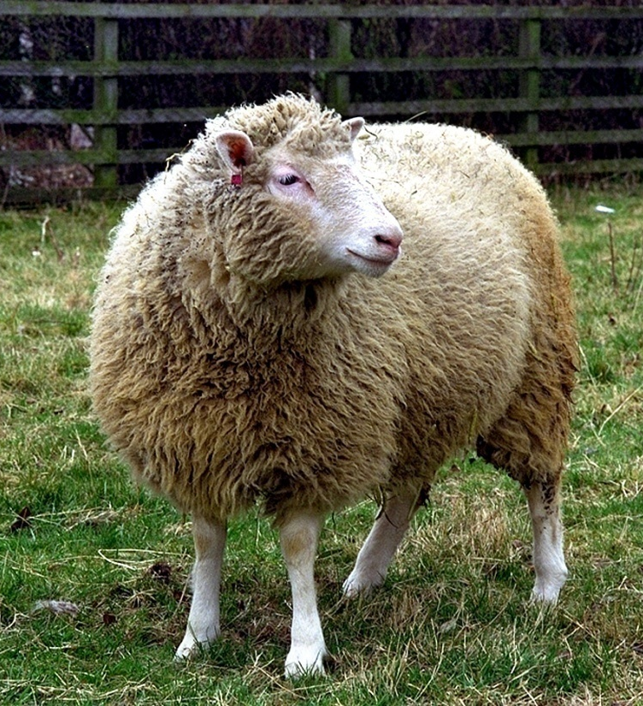
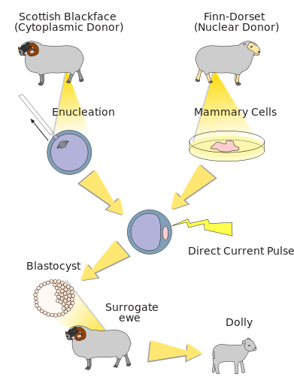
The First Cloned Mammal
Born on 5th July, 1996 at Roslin Institute, Edinburgh, Scotland

Slide 32
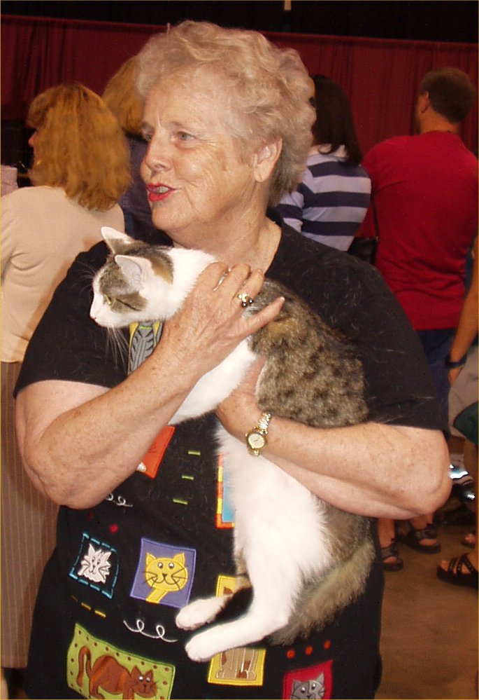
The First Cloned Cat
In 2001, scientists at Texas A&M University created the first cloned cat known as Copy Cat/Cloned Cat (CC).

Slide 33

Selecting Best Possible Features from Parents: Science Fiction Film
Directed by | Andrew Niccol
Produced by | Danny DeVito Michael Shamberg Stacey Sher Gail Lyon
Written by | Andrew Niccol
Starring | Ethan Hawke Uma Thurman
Music by | Michael Nyman
Cinematography | Sławomir Idziak
Edited by | Lisa Zeno Churgin
Production company | Jersey Films
Distributed by | Columbia Pictures
Release date | October 24, 1997
Running time | 106 minutes
Country | United States
Language | English
Budget | $36 million
Box office | $12.5 million^{[1]}
Notes:
In a 1997 review of the film for the journal Nature Genetics, molecular biologist Lee M. Silver stated that "Gattaca is a film that all geneticists should see if for no other reason than to understand the perception of our trade held by so many of the public-at-large".

Slide 34
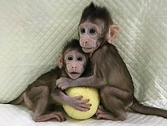
The first cloned primate
Zhong Zhong and Hua Hua born November 2017

Slide 35
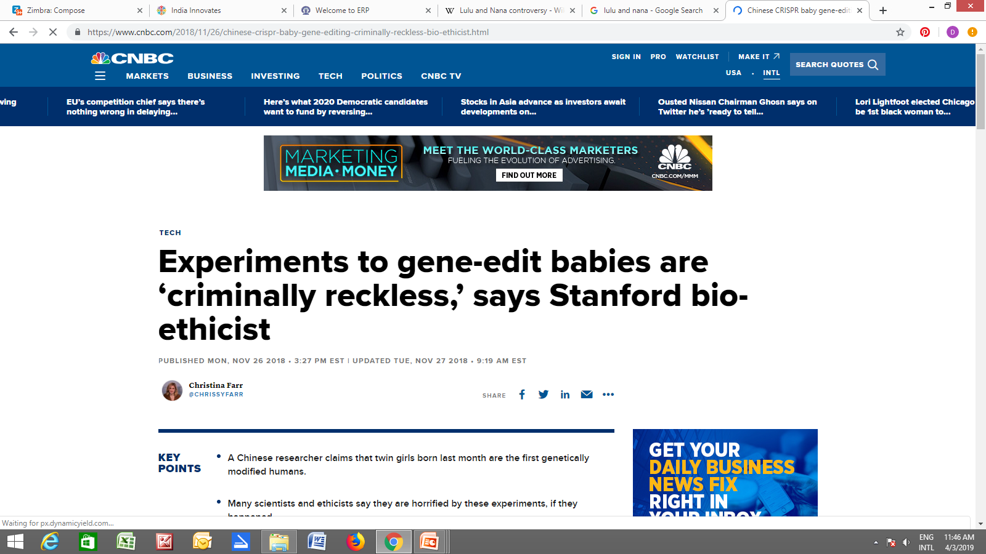
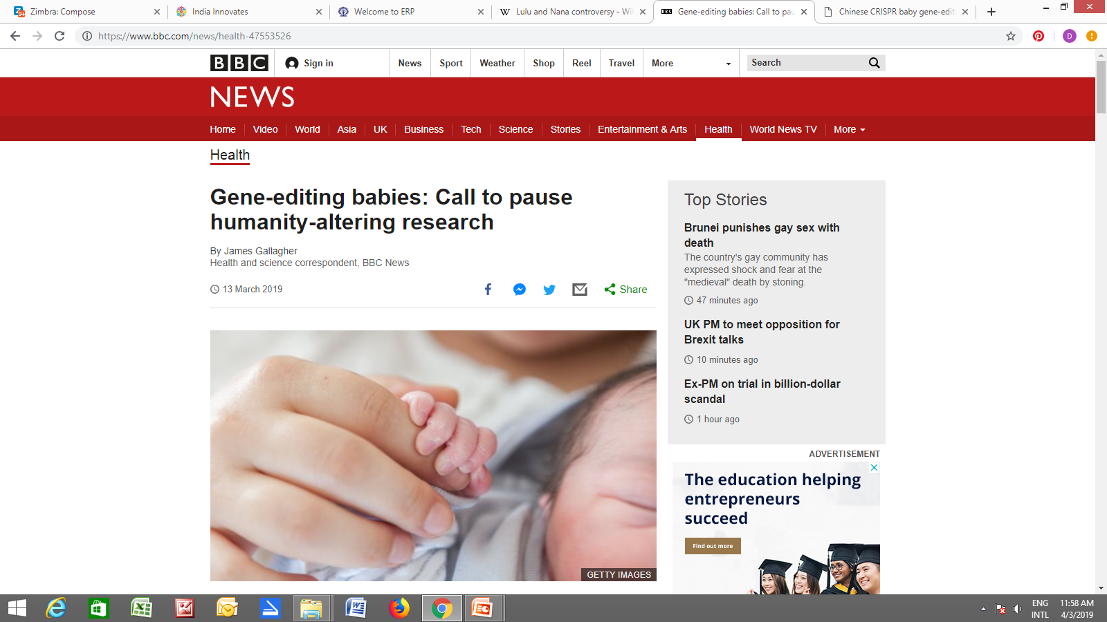
“Lulu and Nana”
He Jiankui

Slide 36
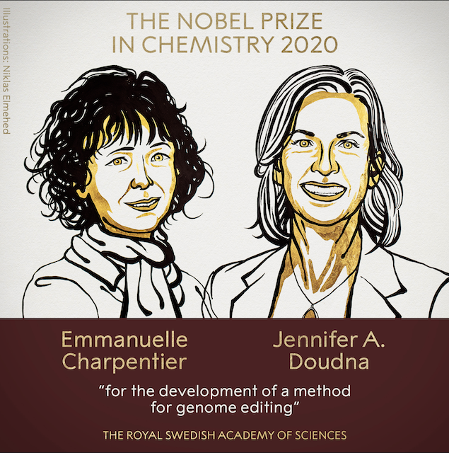
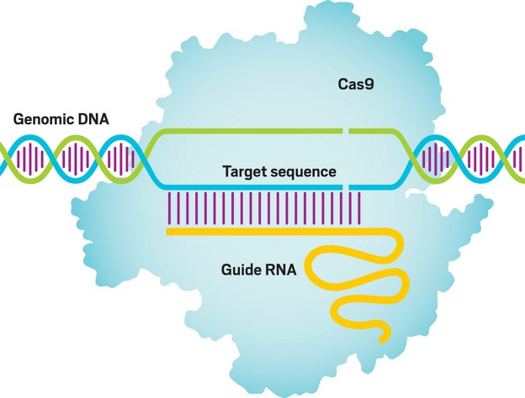
Nobel Prize for CRISPR-based Genome Editing Method

Slide 37
Thank You

